Slide 1
Git 指令教學
SFW/Johnny
2015/10/15

Slide 2
Outline
Git 優點以及名詞定義
Git 安裝與設定
Git 指令簡介
Git flow簡介
Repo 簡介
Q & A

Slide 3
Git 優點
離線操作
查詢log以及diff版本差異.
Commit 變更,建立branch.
Merge branch.
只要你不上傳變更,或取得最新程式碼,都可以離線操作.
Git 分散式儲存版本變更,每個使用者都有完整的版本記錄.
Server故障的情況下,很容易就能救回資料.
Git建立branch速度快
建立branch速度超級快,可以用來做許多實驗.

Slide 4
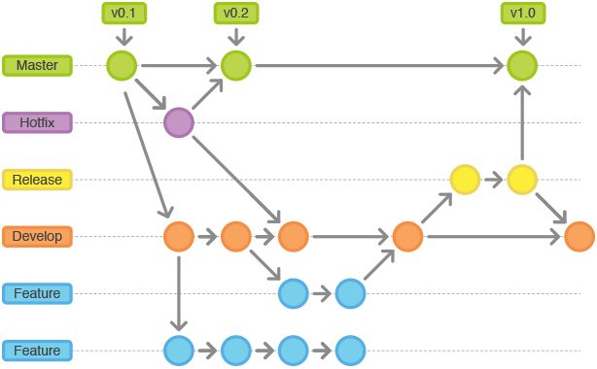
名詞定義
可以用commit id或tag名稱來表示一個節點
merge
Branch可以有很多個,當你切到某個branch工作時,你的環境會在該branch最後一個節點上
每個commit都可以看成一個節點
Notes:
你的工作區所在的節點有個特別名稱叫作HEAD
可以使用git checkout commit_id去切換HEAD所在位置(切換至任一commit節點上) (git checkout tag_name)
可以使用git checkout branch_name去切換HEAD所在位置(該branch最後一個節點上)
開發時必須切到某個branch(HEAD必須停留在某branch最後一個節點上)
(不能當個無根的浮萍,除非你只是想要得到那時的codes)
所以想要在某個節點上開始開發,必須先在該節點建立一個branch,
再切到該branch上, HEAD就會停留在該branch最後一個節點上.

Slide 5
Git 安裝與設定 (1/2)
Installation:
# sudo apt-get install git
# sudo apt-get install gitk
Global Setting:
# git config --global core.editor gvim
# git config --global push.default current
# git config --global user.name "johnnychiang"
# git config --global user.email "johnnychiang@socle-tech.com"
Path of the config file:
# cat ~/.gitconfig
Notes:
# git config --global push.default simple

Slide 6
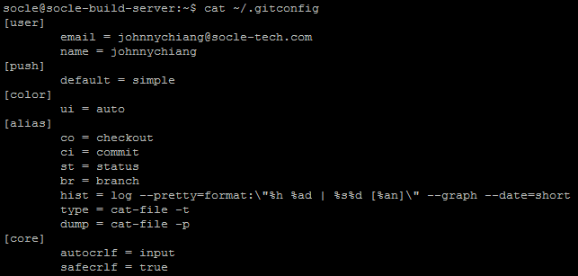
Git 安裝與設定(2/2)
Notes:
Simple means push to the upstream.
Current means push any local branch which has the same branch name as remote branch.

Slide 7
Git 開發流程
# git clone XXX.git
建立git workspace
# git branch –a
# git checkout YYY-branch
切到開發用的branch
Modified codes
# git commit -a -m "message"
修改code並且commit
# git pull
拉最新的code merge
# git push
將修改上傳回git server

Slide 8
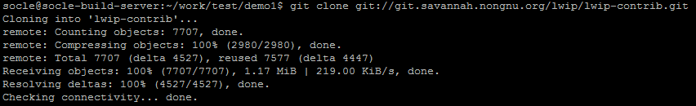
Git command: clone repository
git clone git://git.savannah.nongnu.org/lwip/lwip-contrib.git
git clone git://git.savannah.nongnu.org/lwip/lwip-contrib.git LwIP
git clone git://git.savannah.nongnu.org/lwip/lwip-contrib.git
--branch DEVEL-1_4_1 LwIP-1_4_1

Slide 9
Git command: create repository
# git init
# git add .
# git commit -m "Init Commit"

Slide 10
Git command: status (1/2)
File has 4 states in git workspace:
Untracked file.
沒有在git版本控制上的檔案.
Tracked file with no changes. (git status不會顯示這類檔案)
在git版本控制上的檔案,沒有變更.
Tracked file with changes which is not staged for commit
在git版本控制上的檔案,有變更.
沒有放在要commit列表上.
Tracked file with changes which has been staged to be committed
在git版本控制上的檔案,有變更.
放在要commit列表上.

Slide 11
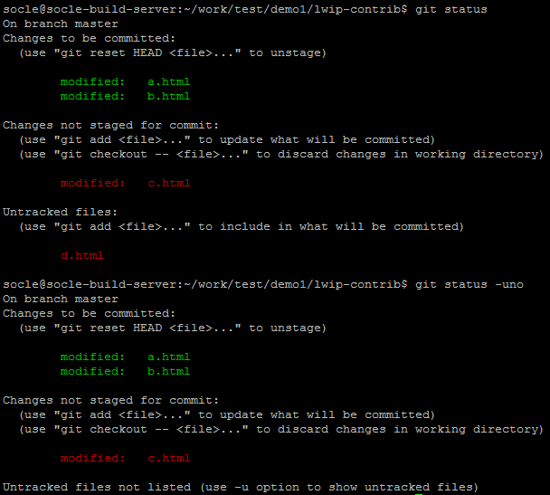
Git command: status (2/2)
# git status -uno
do not show untracking files.
Notes:
echo "<h1>Hello, World\!</h1>" >> b.html
echo "<h1>Hello, World\!</h1>" >> a.html
echo "<h1>Hello, World\!</h1>" >> c.html
echo "<h1>Hello, World\!</h1>" >> d.html
git add a.html
git add b.html
git status
git status -uno

Slide 12
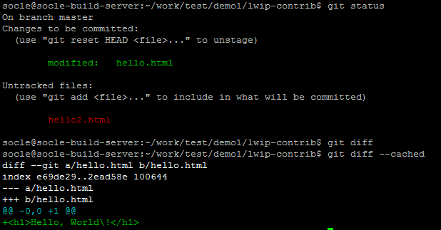
Git command: diff
# git diff [--cached] [filename]
有加上--cached的話是看,在commit列表上的檔案diff.
沒有加上--cached的話是看,還沒在commit列表上的檔案diff.
git diff HEAD看所有的差異.
Notes:
You can use both “git diff” and “git diff --cached”to see all your changes.

Slide 13
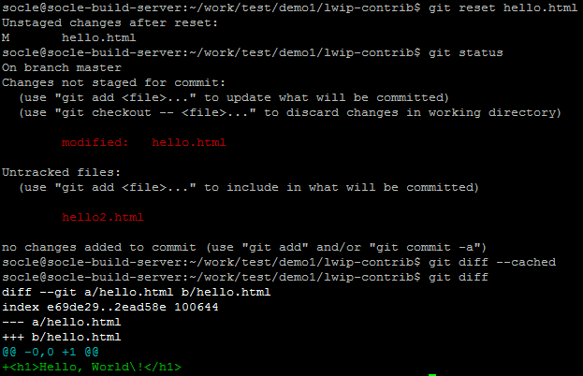
Git command: reset
# git add filename
move the file state from unstaged to staged. (加入commit列表)
# git reset [filename]
move the file state from staged to unstaged. (移出commit列表)
Notes:
You can use both “git diff” and “git diff --cached”to see all your changes.
Or #git diff HEAD
Now only git diff can see the changes.

Slide 14
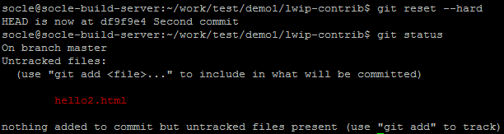
Git command: reset --hard
# git reset --hard
discard all the changes, and return to original codes.
# git checkout hello.html
only revert this file to the original codes.

Slide 15

Git command: clean
# git clean -df
remove all untracked files.
Notes:
So I will use both“git reset --hard” and “git clean -df”to return to the original checkout state.

Slide 16
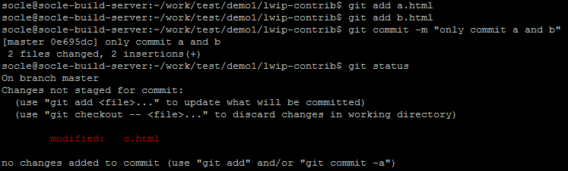
Git command: commit (1/2)
# git commit [-m " message log"]
Only commit the staged changes(partial commit).
If you do not use -m parameter, git will pop default editor. And you must write and save the log on the editor, or it will bypass this commit.
修改一堆檔案,但只用git add加入部分檔案至commit列表,來部分commit.
Notes:
echo "<h1>Hello, World\!</h1>" >> a.html
echo "<h1>Hello, World\!</h1>" >> b.html
echo "<h1>Hello, World\!</h1>" >> c.html
git add a.html
git add b.html
git commit -m "only commit a and b“
git status

Slide 17

Git command: commit (2/2)
# git commit -a [-m " message log"]
Commit both the staged and unstaged changes.
If you do not use -m parameter, git will pop default editor. And you must write and save the log on the editor, or it will bypass this commit.
有修改的全部commit.
Notes:
git commit -a -m “commit all the changes”
git status

Slide 18
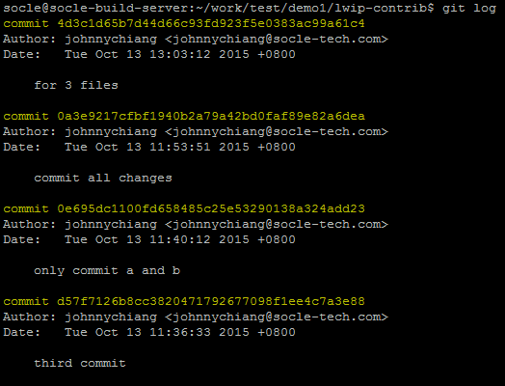
Git command: log (1/2)
# git log
show the commit logs.

Slide 19
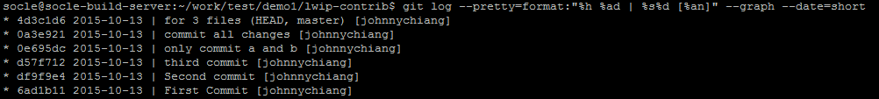
Git command: log (2/2)
# git log --pretty=format:"%h %ad | %s%d [%an]" --graph
--date=short
--pretty="..." defines the output format.
%h is the abbreviated hash of the commit
%d commit decorations (e.g. branch heads or tags)
%ad is the commit date
%s is the comment
%an is the name of the author
--graph tells git to display the commit tree in the form of an ASCII graph layout
--date=short keeps the date format short and nice

Slide 20
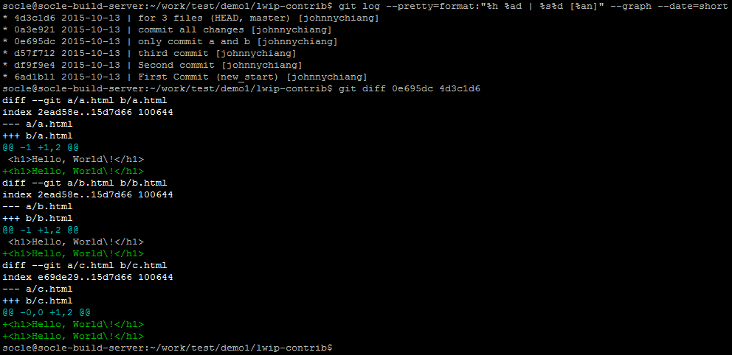
Git command: diff
# git diff commit_id1 commit_id2
We can use diff command to get the differences between two commits.

Slide 21


Git command: tag
# git tag tag_name
add tag
# git tag [-l]
list tag
# git tag -d tag_name
delete tag

Slide 22
Git command: revert
# git revert commit_id
1. revert(undo) the changes of this commit. (the commit still exists). This behavior will generate changes at current HEAD.
2. use the changes to add a revert commit.
3. both original and cancelled commits are seen in the history of the branch.
# git reset -hard commit_id
1. HEAD will jump to that commit.
2. Discard any commits after that commit.
3. The discard commits will become unreferenced commits unless you use a tag to mark it.
Notes:
cp a.html d.html
cp a.html e.html
git add d.html
git commit -m "add d.html"
git add e.html
git commit -m "add e.html“
git log
git revert specific_commit_id

Slide 23
Git command: revert
# git revert commit_id
1. undo該commit所做的任何改變.
2. 將這次undo的改變,commit下來.
3. 所以在log上,兩筆commit都看的到.
# git reset -hard commit_id
1. HEAD will jump to that commit.
2. 直接砍掉在該commit之後的所有commit.
3. 所以在log上甚麼都看不到.
4. 只能用在還沒push之前的commit. (push過的commits都不能動,因為已經在Server上跟別人共用的)
Notes:
cp a.html d.html
cp a.html e.html
git add d.html
git commit -m "add d.html"
git add e.html
git commit -m "add e.html“
git log
git revert specific_commit_id

Slide 24
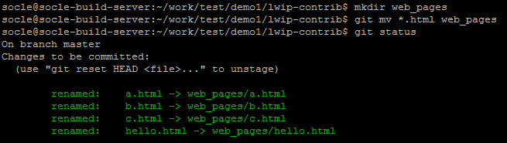
Git command: mv
# git mv file_src_path folder_dst_path
move the file to a specific folder.

Slide 25
Git command: branch (1/2)
# git branch branch_name commit_id
Add branch_name based on commit_id.
# git branch -a
Show all the branches and current branch.
# git checkout branch_name
Switch to that branch.
# git checkout -b branch_name commit_id
建立一個新的branch,並直接切到該branch上面.
Notes:
Commit_id/tag_name/branch_name 都可以代表從哪個節點生出branch.
branch_name 該branch最後一個節點.

Slide 26
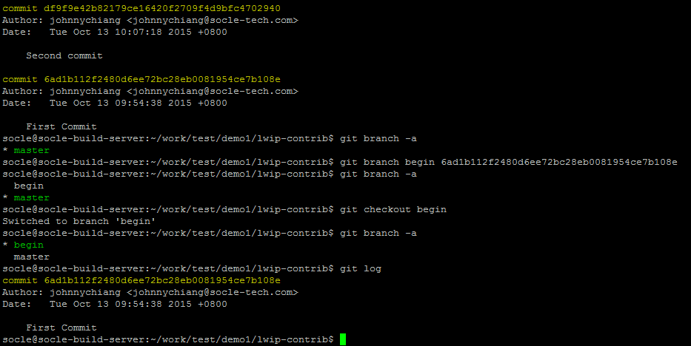
Git command: branch (2/2)

Slide 27
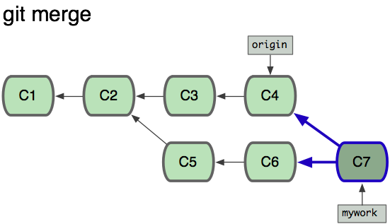
Git command: merge
# git merge branch_name
會將分支點之後,branch_name上所做的修改,commit成另一個節點.
如同底下C7與C6的差異,就是C3+C4. (C7內容包含C3+C4+C5+C6)
如果在mywork branch上面下了git push命令,就會將C7 push回origin branch. (origin是remote branch情況下)
如果在origin branch上面下了git merge mywork命令,origin會移動到C7上,這是. (origin是local branch情況下)
而在origin branch上的C7與C4的差異,就是C5+C6.
Notes:
# git checkout mywork
# git merge origin
----------------------------------------------------
# git pull
EQU
# git fetch
# git merge origin

Slide 28
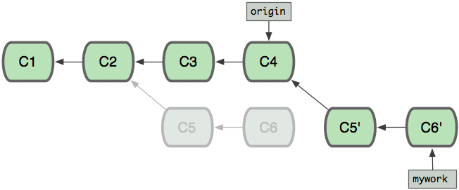
Git command: rebase
# git rebase branch_name
原來分支點上,C5的parent是C2, rebase就是將C5的parent改成C4.
這樣比起merge來說,少了一個merge commit節點.
就最終結果來看,rebase命令與merge命令產生出來的結果是一樣的,只有commit tree長相不一樣.
Notes:
# git checkout mywork
# git rebase origin
---------------------------------
# git fetch
# git rebase origin

Slide 29
Git command: pull/push
# git pull
git pull == git fetch + git merge origin/master.
git fetch == origin/master更新到最新.
更新到git server上最新的程式碼.
origin/master只是示意. (remote可能不叫origin, track的branch可能不叫master)
# git push
將本地commit上傳到git server.
Notes:
# git checkout mywork
# git rebase origin
---------------------------------
# git fetch
# git rebase origin

Slide 30
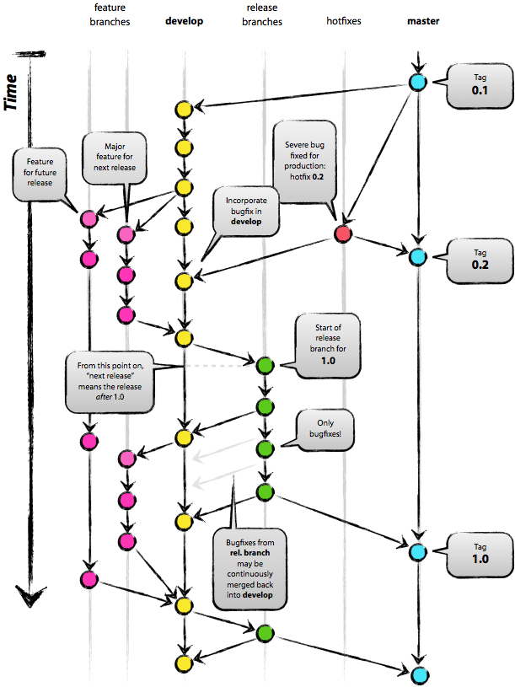
Git flow (1/3)
Notes:
Branch 滿天飛的情況下,如何能夠有品質的開發/Release,
這需要很好的work flow,有人想出了這個flow.
並且提供tools讓你能follow這個work flow.

Slide 31
Git flow (2/3)
主要分支
master: 永遠處在 production-ready 狀態
develop: 最新的下次發佈開發狀態
支援性分支
Feature branches: 開發新功能都從 develop 分支出來，完成後 merge 回 develop
Release branches: 準備要 release 的版本，只修 bugs。從 develop 分支出來，完成後 merge 回 master 和 develop
Hotfix branches: 等不及 release 版本就必須馬上修 master 趕上線的情況。會從 master 分支出來，完成後 merge 回 master 和 develop
Git flow安裝
sudo apt-get install git-flow

Slide 32
Git flow (3/3)
How to initiate git for git flow
$git flow init -d
How to create feature/release/hotfixs branch
$git flow feature/release/hotfix start "branch name"
How to push the feature/release/hotfix branch to remote repository
$git flow feature/release/hotfix publish "branch name"
How to pull the feature/release/hotfix branch from remote repository
$git flow feature/release/hotfix track "branch name"
How to close feature/release/hotfixs branch
$git flow feature/release/hotfix finish "branch name"

Slide 33
Repo (1/2)
Install repo
$ curl https://storage.googleapis.com/git-repo-downloads/repo > ~/bin/repo $ chmod a+x ~/bin/repo
是用來管理眾多git repositories.
Google開發的程式,使用python language.
$mkdir L8028-lite $cd L8028-lite $repo init -u git@10.63.246.9:CDB/manifests/Linaro-13.07/linux/l8028-lite.git $repo sync $repo forall linux u-boot -c git checkout -b master origin/master $repo forall linux u-boot -c git checkout -b develop -t origin/develop $repo forall linux u-boot -c 'git flow init -d'

Slide 34
Repo (2/2)
Manifest git存放default.xml.
用repo來init的話,會將default.xml改存在.repo/manifest.xml.
<?xml version="1.0" encoding="UTF-8"?> <manifest> <remote fetch="ssh://git@10.63.246.9/CDB/" name="origin"/> <default remote="origin" revision="refs/heads/master" sync-j="4"/> <project name="Socle/Linux/build-v2.git" path="build" remote="origin"> <copyfile dest="Makefile" src="Makefile"/> <copyfile dest="config.mk" src="configs/config_l8028-lite.mk"/> <copyfile dest="boot.txt" src="uboot_script/l8028-lite.txt"/> </project> <project name="ext-toolchain/gcc-linaro-arm-linux-gnueabihf-4.8-2014.02_linux" path="linux-toolchain-eabi"/> <project name="linaro/android_linux-3.10.1.git" path="linux"/> <project name="linaro/u-boot-2013-01.git" path="u-boot"/> <project name="internal/sw_dbg.git" path="internal/sw_dbg"/> <project name="buildroot" path="buildroot" revision="refs/heads/2014.05"/> <project name="ON2/g1_decoder_v1.0" path="external/VPU/g1_decoder"/> <project name="ON2/h1_encoder_v1.0" path="external/VPU/h1_encoder"/> <project name="external/free/linux-mpu9150-5.1.1" path="external/free/linux-mpu9150"/> </manifest>

Slide 35
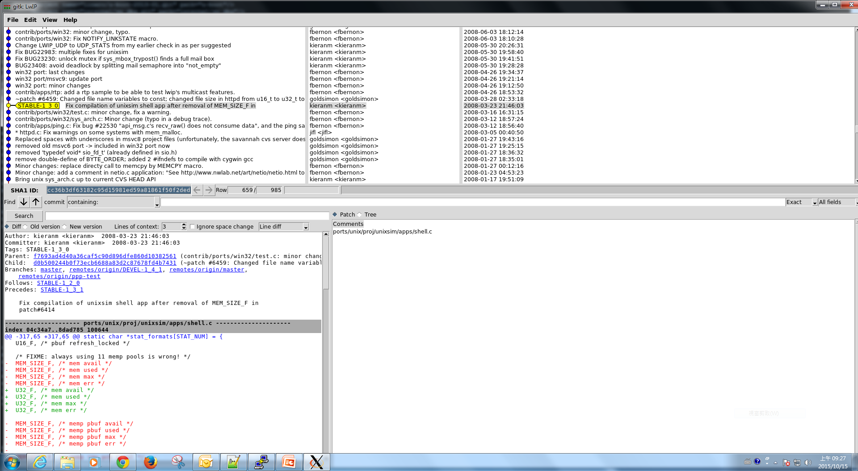
gitk
Notes:
# gitk --all &

Slide 36
Reference
http://githowto.com/
http://10.63.246.9/mediawiki/index.php/GIT_User_Guide

Slide 37
Q & A

